Slide 1
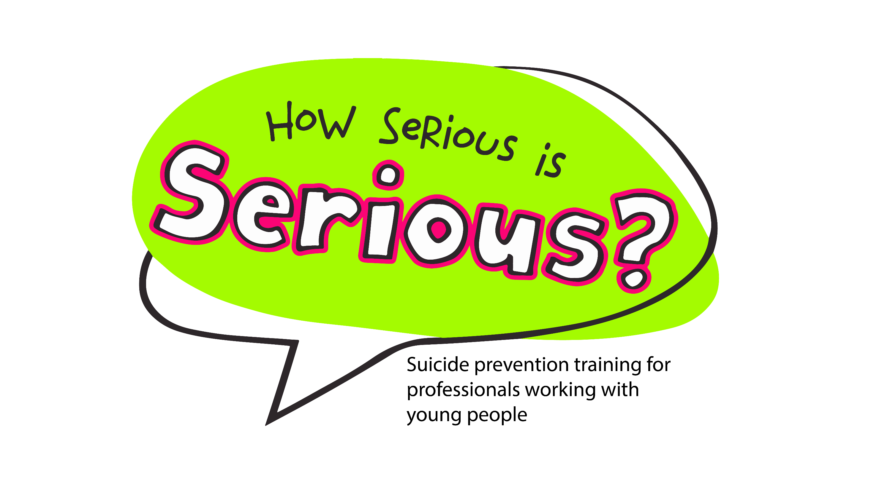
Notes:
Give a trigger warning before we go into the training. Explain we want this to be a safe space. There as a group we need to complete a group agreement – make sure this covers what will happen if a delegates gets upset, leaves the room etc. What type of environment do we want to create here?
When delegates to the virtual room and give them a few mins to get a drink, and remind them if they haven’t filled out their safety plan to do so now.

Slide 2





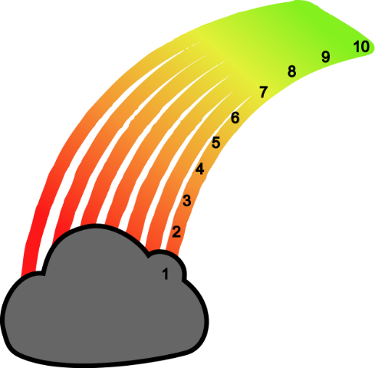
Welcome
Notes:
Serious was funded in 2019 by the coroners office
Came about because people were so afraid to ask about suicide in case it gave the young person the idea
Check in introductions – name, role, number on rainbow
Give a mini tutorial on using the stamp function (for online delivery only)

Slide 3
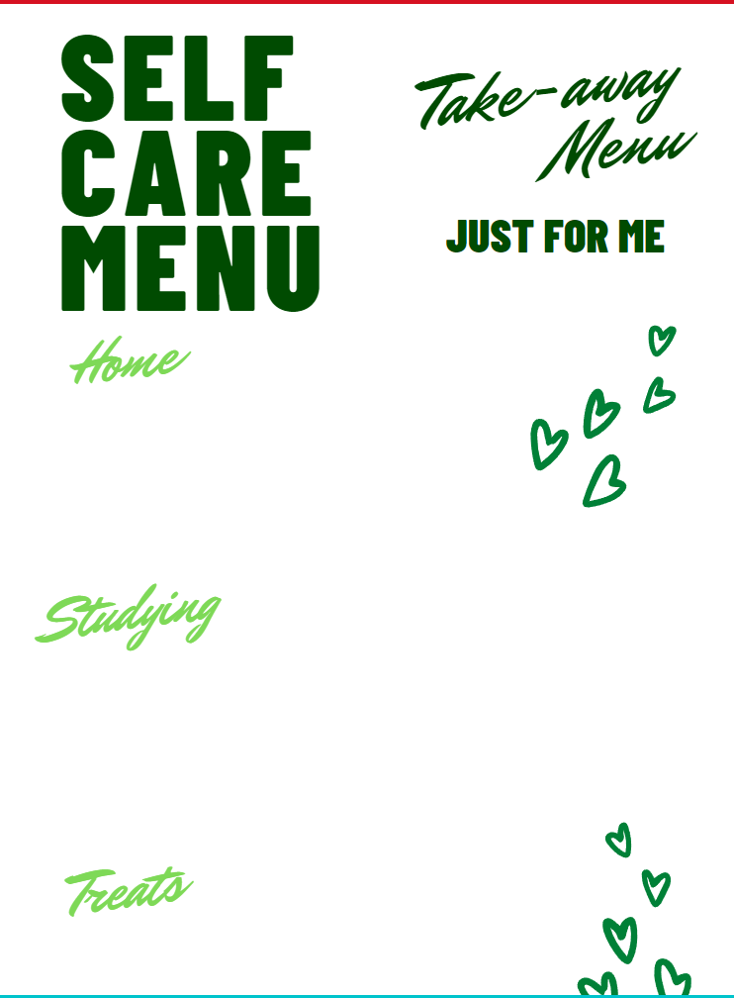

The elephant in the room
“Words, just sometimes, can set you free.” (Matt Haig)
Notes:
Ask delegates to fill out their self care menu to start with as an ice breaker
Lead in to convo about Resilient Ralph
Elephant in the room is suicide because it’s not discussed
Ask delegates – can people point out the elephant in the room?
Discuss the quote by Matt Haig.

Slide 4
Group agreement
Look after yourself

Slide 5
Group agreement
We keep to time.
We respect each others’ views.
Confidentiality ‒ personal details shared in this room remain in this room.
Opt out/personal safety ‒ you don’t do or say anything that makes you feel uncomfortable.
No such thing as a silly question ‒ ask if you don’t understand!
We all get involved and “share the air.”
Enjoy the course ‒ it’s a serious subject matter, but we can enjoy learning.
Any others?

Slide 6
Course aims
To support professionals to have conversations with children and young people about suicide.
To reduce the stigma surrounding suicide.
To enable professionals to spot a child or young person in distress and know how to respond.
To increase confidence in the workforce in dealing with suicide in relation to children and young people.

Slide 7






AND BEHAVIOUR!!
Notes:
What serious acronym stands for.
Remembering this isn’t all about being placed on your, bringing in other support such as CAMHS, GP Support.
O – observe for relapses and BEHAVIOUR.

Slide 8

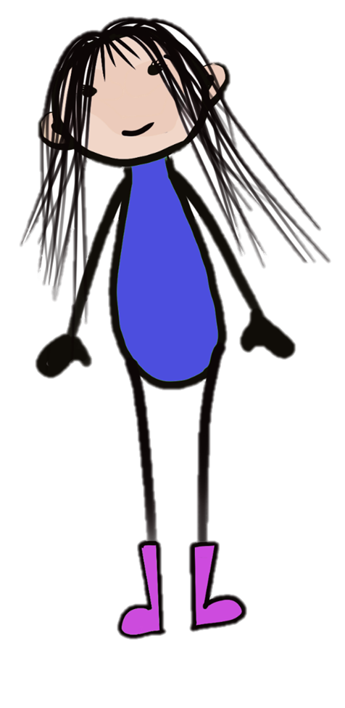
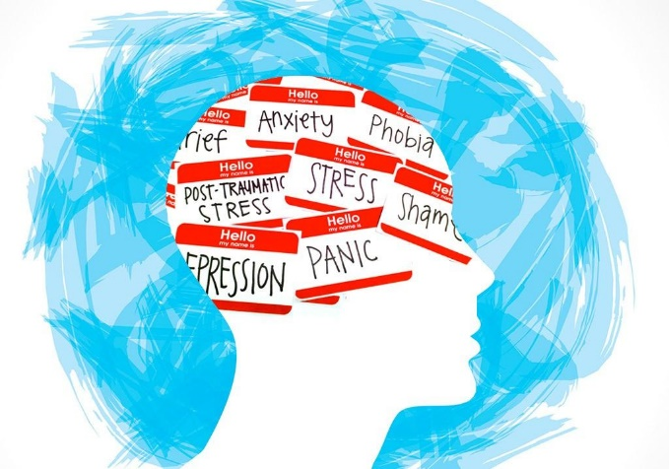
pot the signs
S
“What’s predictable is preventable”
HOWEVER
40% of completed suicides happened ‘out of the blue’
Notes:
Maybe relate to some things we may have seen, I.E Aidan on coronation street, what were the signs if people did see it?
Gave away watch etc. Clues are sometimes there but not always.
Lots of suicides happen out of the blue and can be very quick.

Slide 9
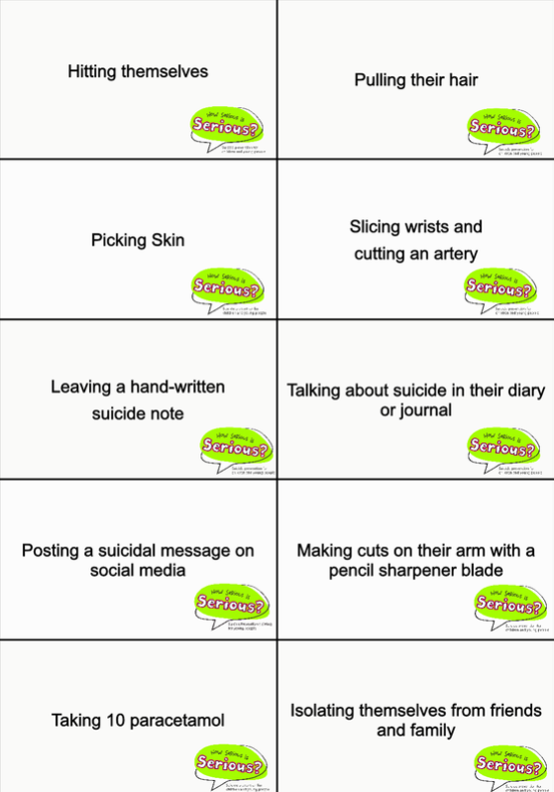
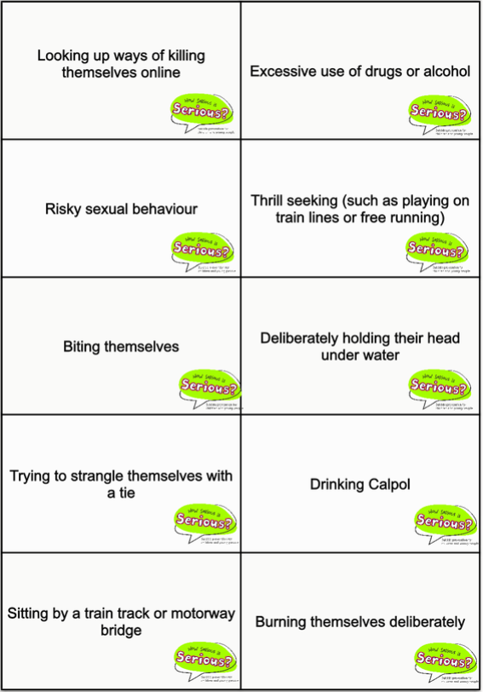
How ‘serious’ are these behaviours?
Notes:
Ask people to stamp on the one they’d be most concerned about. Choose top 3 answers. Make the point that all of these behaviours are concerning as it’s to do with the intent behind that behaviour.

Slide 10
What is suicide/self-harm?
Suicide – The term ‘suicide’ means a deliberate act that is intended to end one’s life.
The National Statistics (ONS) definition of suicide includes all deaths from intentional self-harm for persons aged 10 and over, and deaths where the intent was undetermined for those aged 15 and over.
Self-harm - When somebody intentionally damages or injures their body. It's usually a way of coping with or expressing overwhelming emotional distress (NHS). There are a variety of ways that young people self-harm, not just cutting.
For this training, self-harm is understood as physical injury
inflicted as a means to manage an extreme emotional state
- it can be life-saving or self-destructive.
Notes:
Suicide: There must be enough evidence for the coroner to be able to make the decision that it was classed as death by suicide. Quite often with CYP lots of cases are not reported by suicide. Often classed as ‘’death by misadventure’/ i.e. if on drugs or consumed alcohol. Liverpool has a great coroner Andrew Rubello. Talk about the ‘’commit’’ and complete here with regards to the laws and history around suicide. Burials on church grounds we not allowed due to breaking the law.
Self harm: Doesn’t mean that if someone self harms that it will lead to suicide, however those who have died by suicide have a history of self harming.

Slide 11
Links between self-harm and suicide
The National Confidential Inquiry into Suicide in Mental Health (2019) reveals that self-harm was reported in 52% of those under 20 who died by suicide.
It is, therefore, to be seen as a risk factor for suicide. However, most children and young people who self-harm are not suicidal. Self-harm is often a coping strategy which can serve various functions including:
Dealing with distressing emotions
To feel real/alive rather than numb
To enlist help or concern
To keep people away
To regulate their emotions by experiencing pain
“For the vast majority of young people, self-harm is a coping strategy
intended to help them continue with life, not end it; however,
young people who self-harm are at a higher risk of completing
suicide than the general population.” (Hawton and James, 2008).
Notes:
The National Confidential Enquiry into Suicide and Safety in mental health is the reference for this slide.

Slide 12
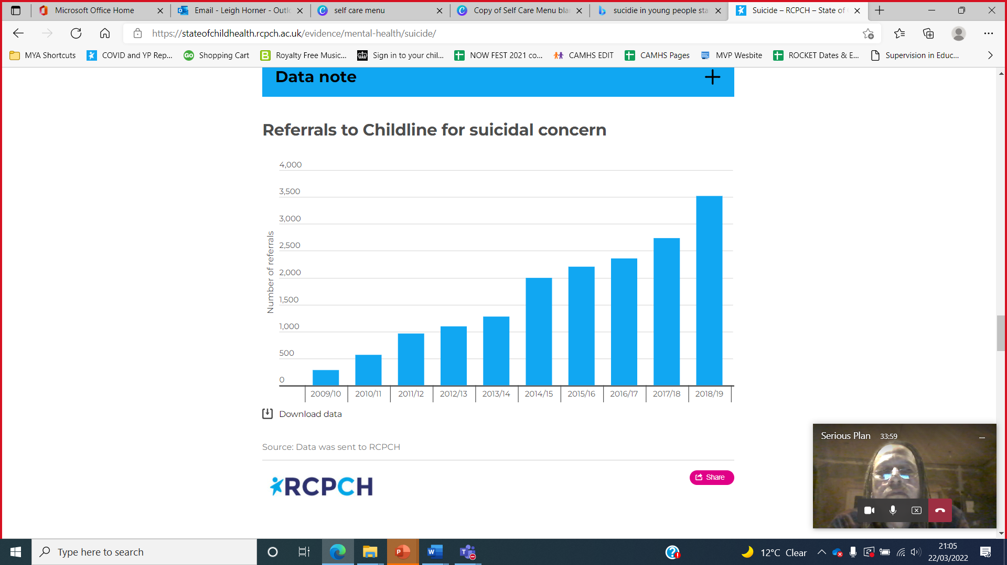
Children/young people and suicide
Over 200 school children die through suicide every year in the UK, making it the biggest killer of young people (Papyrus).
Nearly 25% of young people experience feeling suicidal at least once in their lives.
90% of young people counselled were categorised as feeling suicidal and 10% of these had planned or attempted suicide. (Childline).
The majority of calls to Childline about suicide came from 12-15-year-olds; however, the highest increase had been seen in under 11-year-olds.
¾ of registered deaths were male, 3,925.
Over 105,000 Childline counselling sessions in 2023 were for children struggling with mental health issues (NSPCC)

Slide 13
Children/young people’s contact with Childline
In 2023/24, the top five main concerns that children and young people talked to Childline counsellors about were:
1. Mental and emotional health and wellbeing.
2. Suicidal thoughts and feelings.
3. Family relationships.
4. Self-harm.
5. Friendship issues.
(NSPCC)

Slide 14
Children/young people and suicide
Suicide was the leading cause of death for males and females aged between five to 34 in 2019.
An average of 79 students aged 18-21 died by suicide between 2011-2021 (most common in October and April – reflective of exam times) (National Confidential Inquiry).
Each suicide leaves behind as many as 130 people who report they directly knew the person. This means that there are probably up to 25 people for each suicide who have a great deal of distress following the suicide and are probably in need of services to get through the intense emotions.
There is some evidence that suicide rates are unequal between different ethnic groups.
We should recognise the challenges that neurodivergent
individuals in our society face, including the increased risk of suicide.
Notes:
Not to talk about methods in a group setting with YP.
• Suicide rates vary between ethnic groups, with White and Mixed-ethnicity groups showing the highest rates, but data is limited, and these categories are broad. Racism, discrimination, and unequal access to mental health services also contribute to increased risks and disparities in care for people from minoritised backgrounds.
• Many people with neurodivergent conditions report facing discrimination, bullying, and marginalisation in society, which can lead to feelings of isolation, hopelessness, and despair. These negative experiences can significantly impact mental health and increase the risk of suicide.

Slide 15
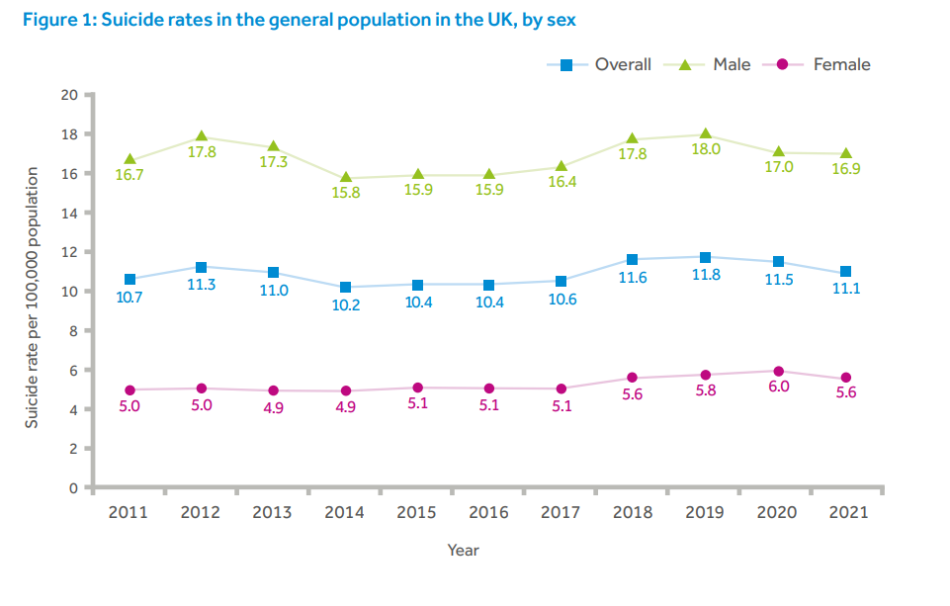
UK Population Suicide
Between 2011- 2021 there were 7,313 suicides by children/young people aged under 25, an average of 665 deaths per year.
1,208 were aged under 18, an average of 110 deaths per year.
(National Confidential Inquiry into suicide & safety & mental health)

Slide 16
Children/young people and suicide
Academic pressures and bullying were common antecedents in the under-20s, while workplace, housing, and financial problems were more common in those 20-25’s.
Over 200 school children die by suicide each year in the UK (Barnardo’s Campaign St Georges Hall 2017).
Suicide-related internet use in 26% of deaths in those under 20, searching for information on suicide methods or posting messages with suicidal content.
A proportion of children/young people who died had not talked about suicide and had low rates of key stresses.
Notes:
News reported by Papyrus

Slide 17
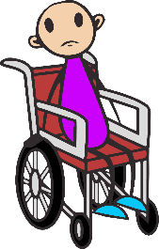
MYTH | FACT
It’s more uncomfortable to ask the question than to be asked.
Notes:
Read out some of the quotes and get them to stamp the screen if they think it’s a myth and fact. Clear the stamps between each statement.

Slide 18

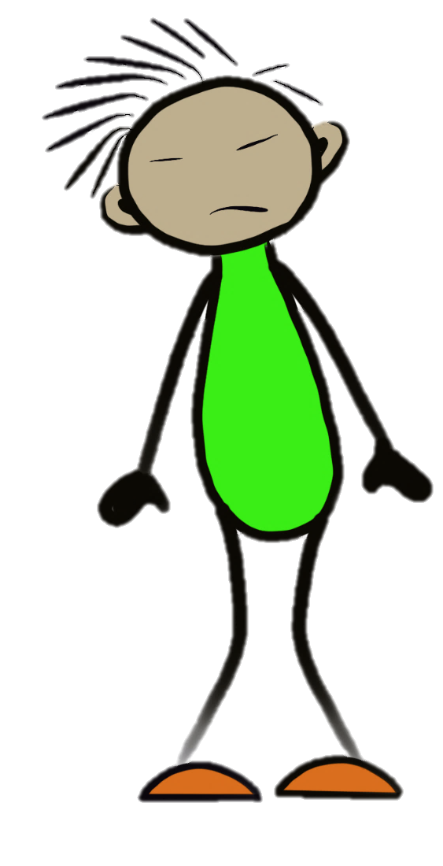
‘Just Ask ME’ Film
Mum
PE Teacher
Teacher
Friend
Girlfriend
Trigger Warning
https://youtu.be/0VhlsijBDLs
Notes:
Watch the film – created by young people around suicide and their perspective. ‘’Just Ask Me’’.
They developed the character around it, what type of things get said, what shouldn’t we say?
Page 6 and 7 in the delegates handbook. Do this in breakout rooms. Give each room a person to focus on and then feedback to main room. So 5 different break out rooms, discuss, then feedback after 5 minutes. Tony make note of character names.
Mum
PE Teacher
Teacher
Friend
Girl friend
Free Resources - Serious Suicide Aware

Slide 19
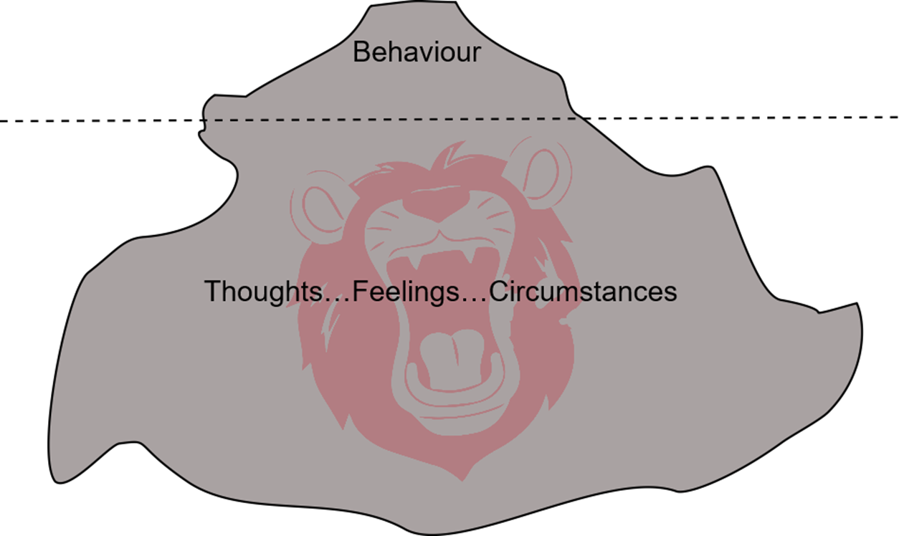
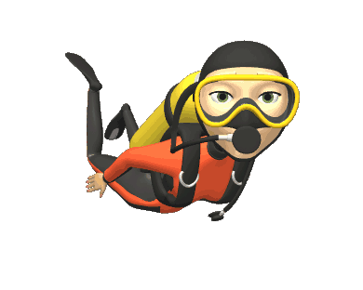
Spotting the signs - behaviour
“All human behaviour has a purpose.”(Pearce)
Notes:
It’s our job as MH responders to dive down beneath the surface, beyond the behaviour to try and spot the ‘Big Thought’ (the thought that is driving, or maintaining the child’s cycle

Slide 20
Spotting the signs - behaviour
Becoming withdrawn from friends and family/Isolating themselves.
Tearfulness and irritability or unpredictable moods.
Sudden outbursts of anger directed at themselves or others.
Loss of interest in activities that they used to enjoy.
Risky or reckless behaviour.
Going out alone, especially at unusual times.
Threatening to or talking about wanting to hurt or kill him/herself.
Creating suicide notes.
Throwing, giving away, or promising to give away valued
possessions to family members or friends.

Slide 21
Spotting the signs - behaviour
Talking about not being around in the future or "going away“.
Searching for and trying to obtain weapons, pills, or other means ways to kill him/herself.
Suddenly in a very positive mood.
Going to bed early or not sleeping.
Displaying signs of mania or being overbearing.
Not retaining information as if things wash over them.
Self-harming.
Any behaviour that is unusual or out of character.

Slide 22
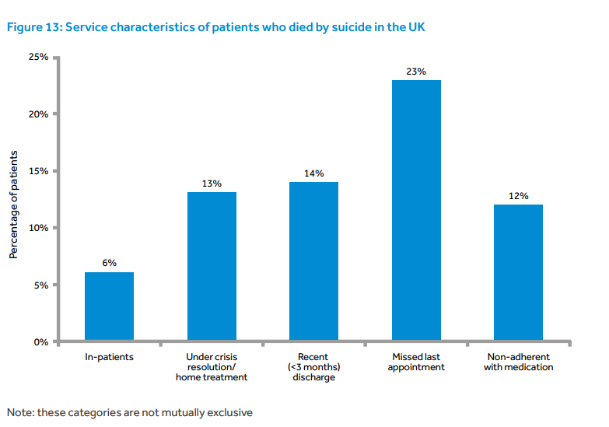
Service user report of suicide
National Confidential Inquiry into Suicide and Safety in Mental Health
Annual Report 2022
(Young people aged under 18)
https://nspa.org.uk/wp-content/uploads/2022/04/NCISH-2022-report-bookmarked-FINAL.pdf
Notes:
46% of patients had contact with services in the week before death NCISSMH
National Confidential Inquiry into Suicide and Safety in Mental Health https://nspa.org.uk/wp-content/uploads/2022/04/NCISH-2022-report-bookmarked-FINAL.pdf
Annual Report 2022 - SUICIDE BY PEOPLE AGED UNDER 18

Slide 23
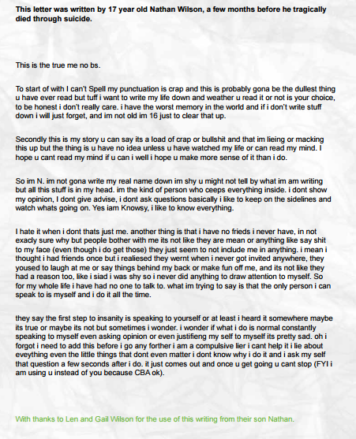


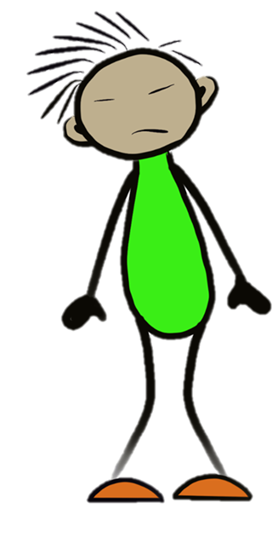
Spotting the signs - thoughts
Do things ever get so difficult that you feel life isn’t worth living?
It seems as though things have been quite difficult lately?
Do you get thoughts about wanting to end your life?
Have you thought about suicide at any point?
Have you thought about killing yourself?
Notes:
Page 6 and 7 in the delegates handbook. Do this in breakout rooms. Give each room a person to focus on and then feedback to main room. So 5 different break out rooms, discuss, then feedback after 5 minutes. Tony make note of character names. What signs would you spot and how would you ask the question?

Slide 24
Spotting the signs - thoughts
Leave me alone.
No one understands me.
What’s the point?
Everyone's got their problems.
They are just going to pass me on.
I can’t trust anyone.
You would be better off without me.
I’m rubbish.

Slide 25
Spotting the signs - feelings
Isolation or feeling alone.
Confused.
Persistent low mood and unhappiness.
Sceptical.
Disconnected.
Feeling like a burden to others.
A sense of hopelessness or no hope for the future.

Slide 26
Spotting the signs – physical
May have lost or gained weight
Showing a dramatic change in personality or appearance
May look tired or pale
May have injuries from self-harm
May be unwell in general
A decline in their hygiene
Not bothering with their appearance
Could be masking through– dressing up, immaculate make-up etc.
Hiding themselves away with their clothes or hair.

Slide 27
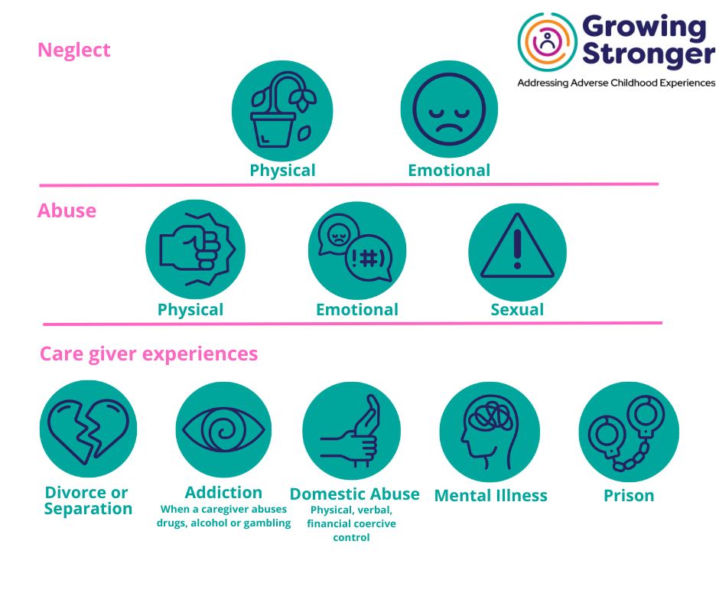
Being ACE-Aware
ACEs (Adverse Childhood Experiences) are events that effect children whilst growing up and are known to have negative effects on health, development and wellbeing
Notes:
Refer them to our ACEs bitesize training

Slide 28
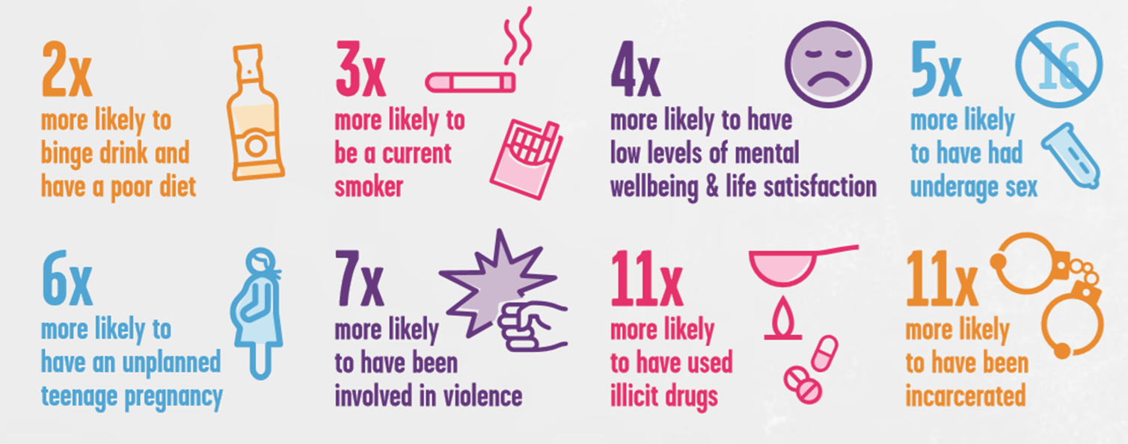

ACEs increase the risk of suicide
Notes:
CDC stands for centre for disease control.
Nadine Burke Harris TED Talk – point to this for more information as this ted talk is a fantastic introduction to ACEs and their impact.
**CHECK STATS ARE UP TO DATE**

Slide 29
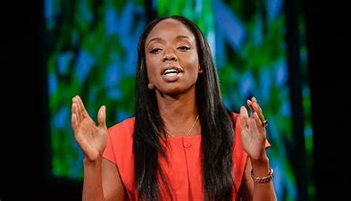
ACEs increase the risk of suicide
Fundamentals
ACEs are not destiny; we all have the power to make a difference
The workforce needs to be ACE-aware and trauma-informed.
Vincent Felitti - (ACEs Study).
Experiencing even one ACE increased the risk of attempted suicide up to five times. (Kaiser Permanente and the Centres for Disease Control and Prevention CDC) Nadine Burke-Harris states in her TED Talk how it increases the risk of suicide up to five times.
''If you have 100 kids that drink from a well and get diarrhoea, you can prescribe them antibiotics, or you can walk over to that well and ask the question,
what is in this well?''​
Notes:
Link 16 mins https://youtu.be/95ovIJ3dsNk
Adverse Childhood Experiences (ACE) - Liverpool CAMHS https://www.liverpoolcamhs.com/aces/what-are-adverse-childhood-experiences/

Slide 30
BREAK

Slide 31

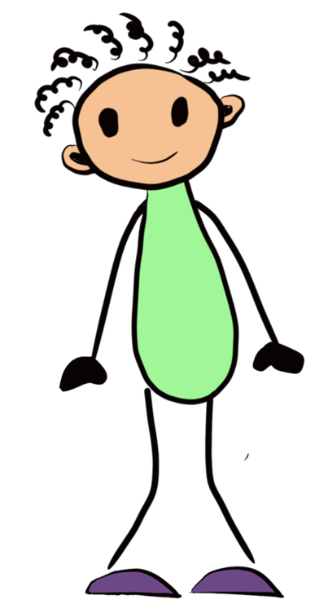

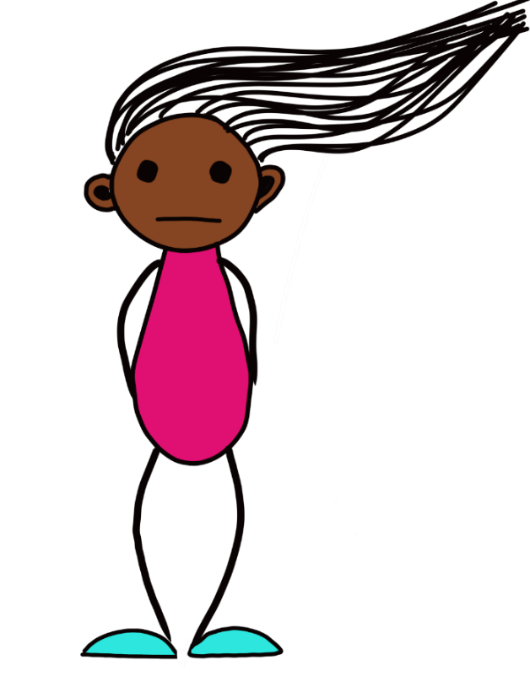



Case studies
Groups to look at their case studies and highlight the signs and symptoms. Groups to identify risk and resilience/protective factors.
Notes:
Split the group into 4 breakout rooms – Jake, Kyle, Ameera, Sophie. These case studies are all in the book. (Refer to manual & copy on resources to hand out
(add additional info in Booklet)

Slide 32
Suicide risk factors in children/young people
Family factors such as mental illness.
Abuse and neglect.
Bereavement and experience of or exposure to suicide.
Bullying.
Suicide-related internet use.
Academic pressures, especially related to exams.
Social isolation or withdrawal.
Physical health conditions that may have a social impact.

Slide 33
Suicide risk factors in children/young people
Alcohol and illicit drugs.
Mental ill health – particularly depression and anxiety.
Self-harm.
Previous suicide attempts.
LGBTQ, Young Carers and Children in Care (CiC).
Transitions.

Slide 34
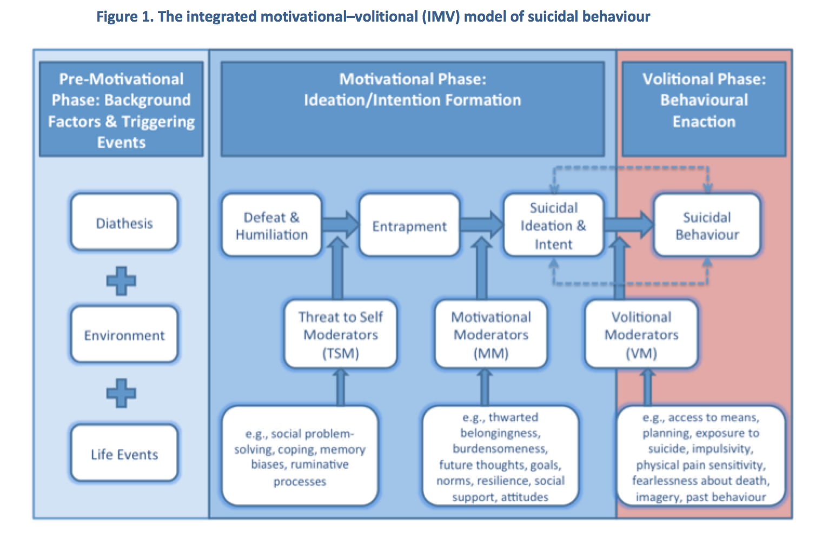
Integrated Motivational-Volitional (IMV) model of suicidal behaviour (O’Connor & Kirtley, 2011)
Notes:
Diathesis means a tendency to suffer from a particular medical condition. (may need clarifying to delegates)
Volitional means relating to the use of one's will.
Motivational Phase: - Talk about the shame around suicide. If this is a public shame then it could be heighted.

Slide 35
Rory O'Connor’s research highlights eight risk factors
The child/young person has access to things that they can use to end their life.
They have planned how they are going to do it.
They have been exposed to suicide or suicidal behaviour through family members or friends.
They tend to be impulsive.
They can tolerate physical pain.
They are not afraid of death.
They can visualise death or dying.
They have previously attempted suicide or self harmed.
Notes:
tony
O'Connor's research highlights eight risk factors
Highlighting Grief & loss

Slide 36
What moves them from suicidal thoughts to suicidal behaviour?
They have:
access to likely means of suicide.
made a plan to end their life.
been exposed to suicidal behaviour from friends or family.
a tendency to act impulsively.
a high pain threshold.
no fear of death or dying or don’t fully grasp the finality of it.
described visualising dying/after death.
attempted suicide before or have a history of self-harm.
Notes:
Talk about shame

Slide 37
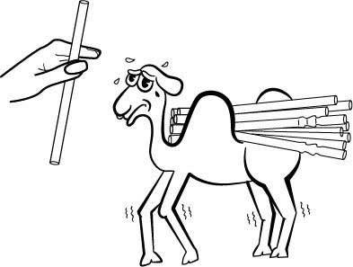
Louis Appleby report
Social isolation.
Bullying.
Family factors such as mental illness.
Suicide-related internet use.
Academic pressures, especially related to exams.
Physical health conditions that may have a social impact.
Alcohol and illicit drugs.
Mental ill health, self-harm and suicidal ideas.
https://research.manchester.ac.uk/en/projects/national-confidential-inquiry-into-suicide-and-safety-in-mental-h
Notes:
National Confidential Inquiry into suicide (Emotional compassion biased)
Louis Appleby - Kate to read this.
https://research.manchester.ac.uk/en/projects/national-confidential-inquiry-into-suicide-and-safety-in-mental-h

Slide 38
“One of the key symptoms of depression is to see no hope, no future. Far from the tunnel having light at the end of it, it seems like it is blocked at both ends, and you are inside it.”
(Matt Haig)

Slide 39
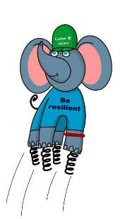


E
nsure you ask about suicide.

Slide 40
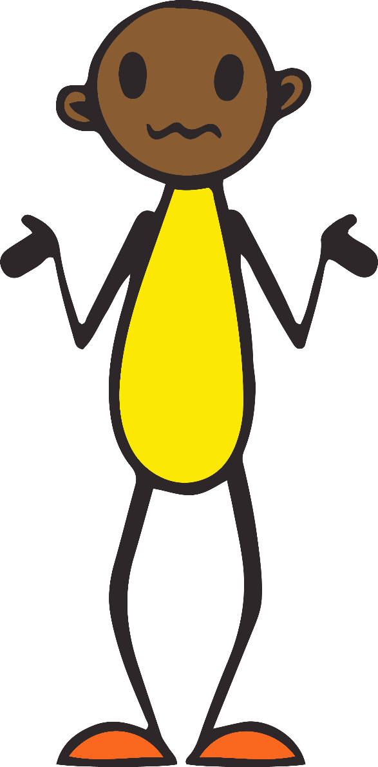
FINE Poem

Slide 41
Safeguarding
Don’t be afraid to ask a child or young person if they are suicidal; it won’t put the idea into their head. On the contrary, giving someone the opportunity to explore their worst fears and feelings may provide them with a lifeline, which makes all the difference between choosing life and choosing death.
Never promise confidentiality.
Adhere to your organisation’s safeguarding policies.
Have a named person in mind and inform the young person that it’s them you will tell if they disclose to you.
Thank them for passing on this information to you. Acknowledge that it was a difficult thing to do.
Notes:
Myth around thinking asking the question will put idea in to their head – being direct and honest with the question.
Raise as a safeguarding issue
Follow your own safeguarding protocol first and foremost.
Has you setting got a mental health policy, does it talk about suicide and the procedure around this?

Slide 42
What language to use
Don’t beat around the bush. Young people need to know that we are not feeling awkward talking to them about this.
Card sort activity looking at helpful and unhelpful ways to talk about suicide.
“The only person I can speak to is myself, and I do it all the time.” (Nathan)
Notes:
KAHOOT
Appropriate or not? Activity.

Slide 43
Active listening skills
1. Ask open questions
Instead of asking questions that only require a yes or no answer, try to ask open questions.
For example, instead of saying: 'Has this been going on a long time?', ask 'How long has this been going on?'.
2. Summarising
This helps to show that you've listened to and understood what's been said.
For example, 'So you're feeling very stressed by your work but still love your job.'
3. Reflecting
Repeating back a word or phrase can encourage people to go on.
If someone says, 'So it's been really difficult recently,' you can keep the conversation going simply by repeating 'Difficult…’.

Slide 44
Active listening skills
4. Clarifying
We all skirt around or gloss over the most difficult things.
If we can avoid saying them, we will. If the person you're speaking with glosses over an important point, saying 'Tell me more about…' or '…sounds a difficult area for you' can help them clarify the points, not only for you but for themselves.
5. Reacting
You don't have to be completely neutral. If whomever you're talking with has been having an absolutely dreadful time of it, some sympathy and understanding are vital.
'That must have been difficult’ or, 'You've had an awful time' – this really helps.

Slide 45

The closed question
What’s your closed question?
Notes:
Discuss in pairs; If stuck, what question would you ask?

Slide 46
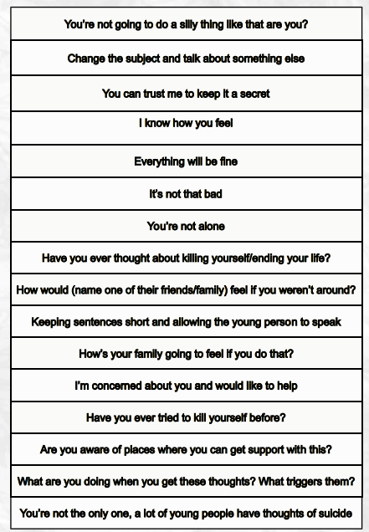
Talking about death and dying
Don’t you know things can change; things will go your way.
If you hold on for one more day. Can you hold on for one more day?
https://youtu.be/uIbXvaE39wM
Notes:
Page 19 in booklets
Not saying ‘’lost’’, for young people with ND conditions can be misinterpreted as they are actually lost.
For those who are experiencing grief, the use of word ‘dead’, ‘died’, can be really tough.
What not to say.

Slide 47

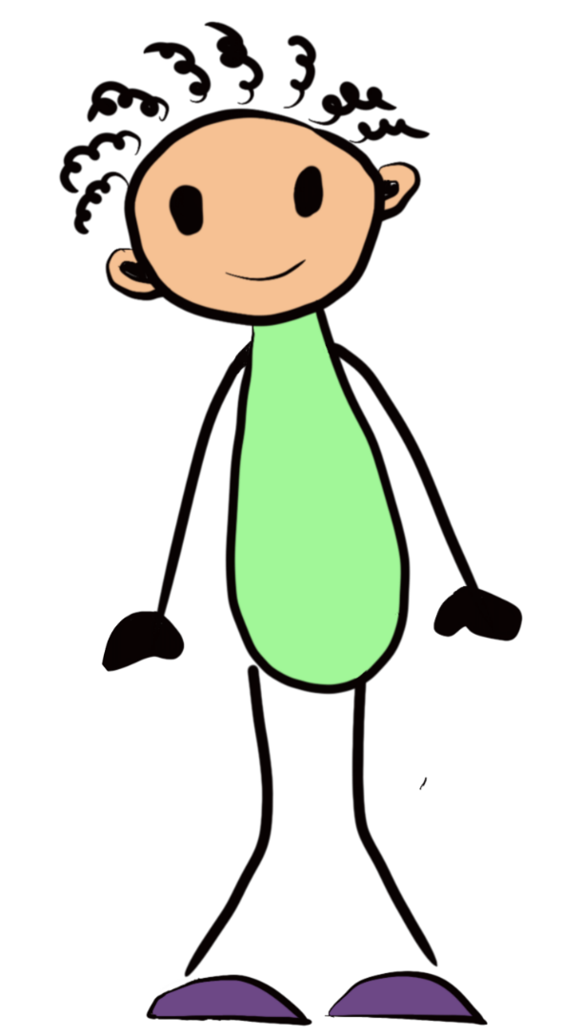
Ambivalence
Notes:
See this as a tug of war. What are the things that pull them back over to the ‘’life’’ side. Go back to the case studies and pull out the signs that would keep the tug of war on ‘’life side’’.
Then talk to delegates, to state that it’s got to come from them and its our role to pick up on what they are telling us, not what we think is the answer for them.
Talk about the ANTS.
Refer to safety plan – it’s all about the here and now, how can we keep you safe right now?

Slide 48


What do we mean?
When talking about ambivalence, we are referring to the simultaneous presence of opposing emotions. It is relatively common, and we may hear it when referring to things such as ''love-hate'' relationships. In terms of suicide, it means that a person's wishes may be both to live and to die.
What to do?
Check that it's OK to have the conversation, so you are invited to talk to them.
Ask about suicide and provide a safe space where judgment is suspended for them to express their story.
Hear their story and allow them the space to explain what's going on, keeping questions open.
Look out for those signs of life: A young person might talk about the future, ''I'm going to my mates tomorrow'', ''next week it’s the football match''. These are signs they are thinking about their future, which could sway them back onto the ''life'' side.
Create a Safety Plan that the young person agrees to.
Confirm actions so there's a real understanding of what's been discussed.
Notes:
See this as a tug of war. What are the things that pull them back over to the ‘’life’’ side. Go back to the case studies and pull out the signs that would keep the tug of war on ‘’life side’’.
Then talk to delegates, to state that it’s got to come from them and its our role to pick up on what they are telling us, not what we think is the answer for them.
PALS Model – goes in to a lot more details and we highly recommend the ASIST Course.
Talk about the ANTS.
Refer to safety plan – it’s all about the here and now, how can we keep you safe right now?

Slide 49

Fleeting or intense thoughts?
Harmless resource hub
Thermometer level
PAIN check
Plan – Have they made a plan?
Access – Do they have access to lethal means?
Intent – Do they feel they would act on these thoughts?
No previous attempts – check if they have attempted suicide before.
https://harmless.nhs.uk/assessment/
Notes:
Harmless Tool – Developed by Oxford NHS Foundation Trust - harmLESS | Young people and suicide https://harmless.nhs.uk/assessment/ – centre of excellence for self harm and suicide prevention.

Slide 50
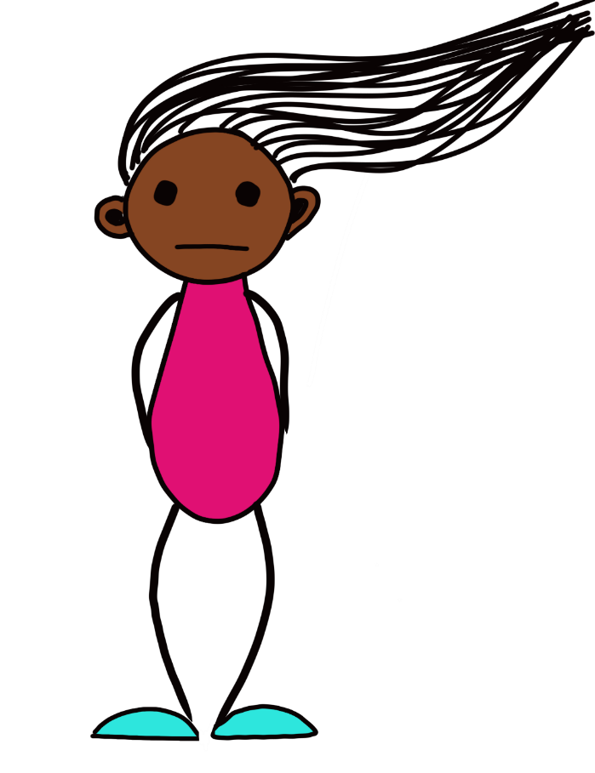
Case Studies
Practice in pairs (optional)
Notes:
Lead into a dialogue and spot the ‘buts’. Signs of
Split the stories out and practice a conversation, try and spot the buts.

Slide 51

espond don’t react.
R
“Suicide is a permanent solution to a temporary problem”
Notes:
** LOOK at suicide bitesize can we add any of this is or from ASIST?** - Tony

Slide 52
Key tips for responding
Follow your instinct and begin conversations with open questions such as, “How are you feeling about…”
Be patient and consistent.
Ask the child/young person how you can help.
Look beyond the self-harm/suicide and see the child/young person.
Give advice and support.
Allow the child/young person to remain in control as much as possible.
Show that you are listening and can empathise.
Offer hope.
Be clear on confidentiality.

Slide 53
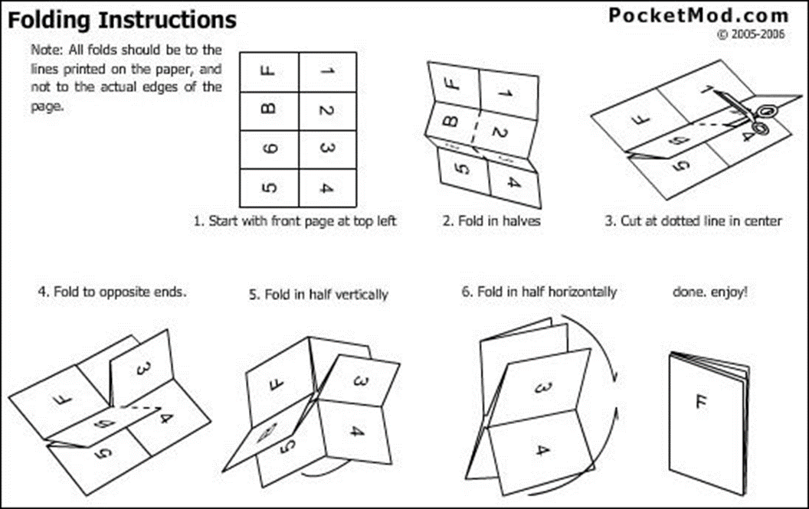
Safety Planning
Notes:
Make sure we have the serious up to date one but just reiterate this might be an updated one than the one they have in the book.

Slide 54
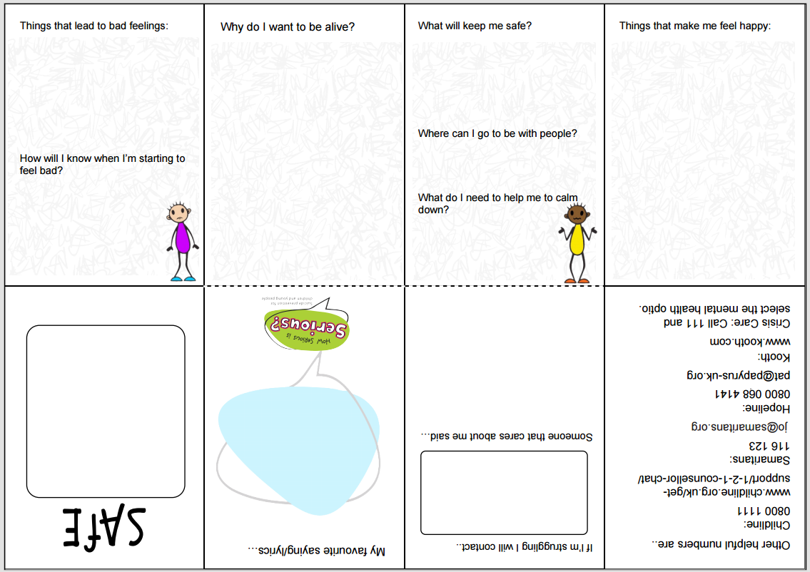

Slide 55
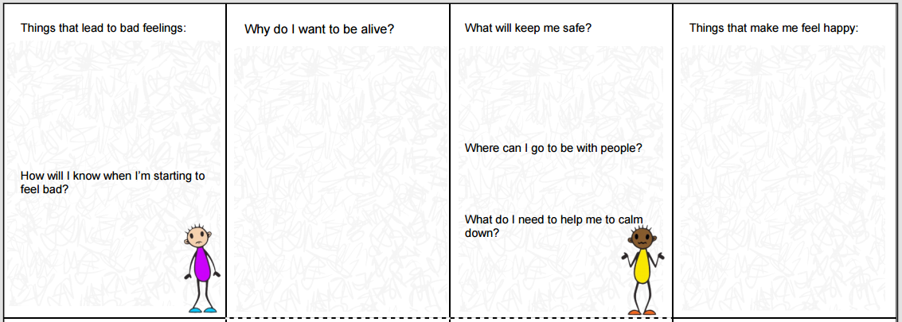

Slide 56
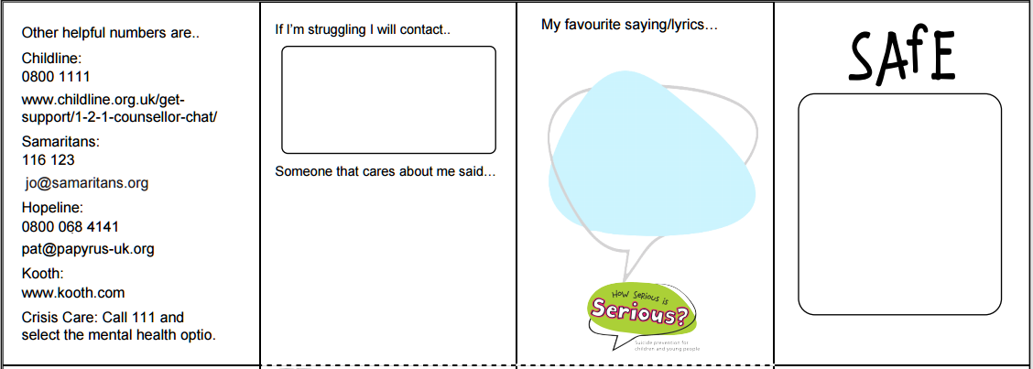

Slide 57
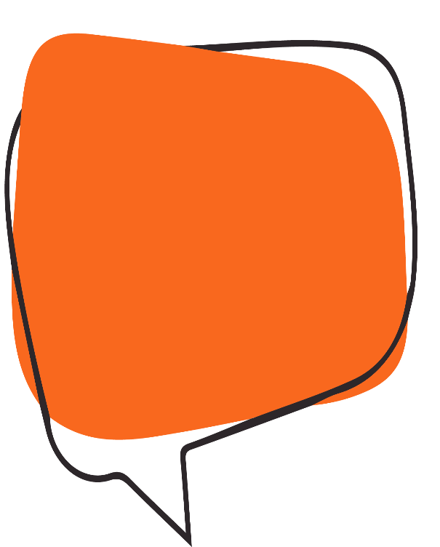
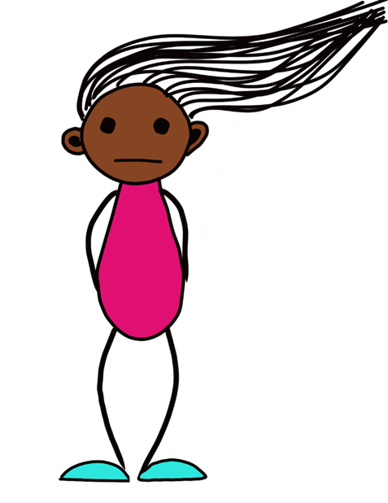
nform others that can help.
I
“You are not alone”

Slide 58
Social Media – a lifeline?
“If you look into the distance, there's a house upon the hill.
Guidin' like a lighthouse
It's a place where you'll be safe to
feel our grace.
And if you've lost your way
If you've lost your way…
…I will leave the light on.”
(Tom Walker)
Notes:
Page 16 in booklets on suicide and technology – age old debate is social media a positive or a negative. Refer them to social media bitesize which looks in to how we can assess out young persons digital life in relation to its impact on their mental health.

Slide 59




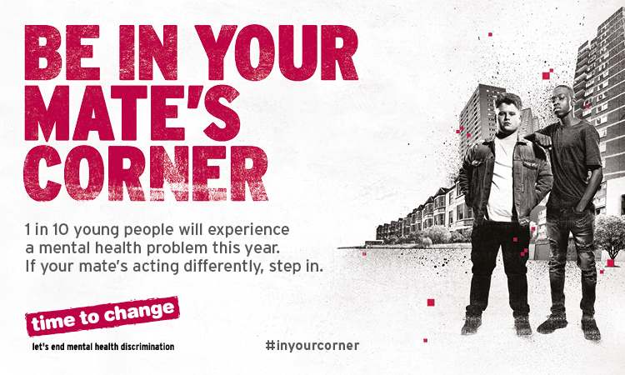

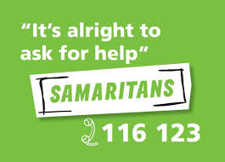

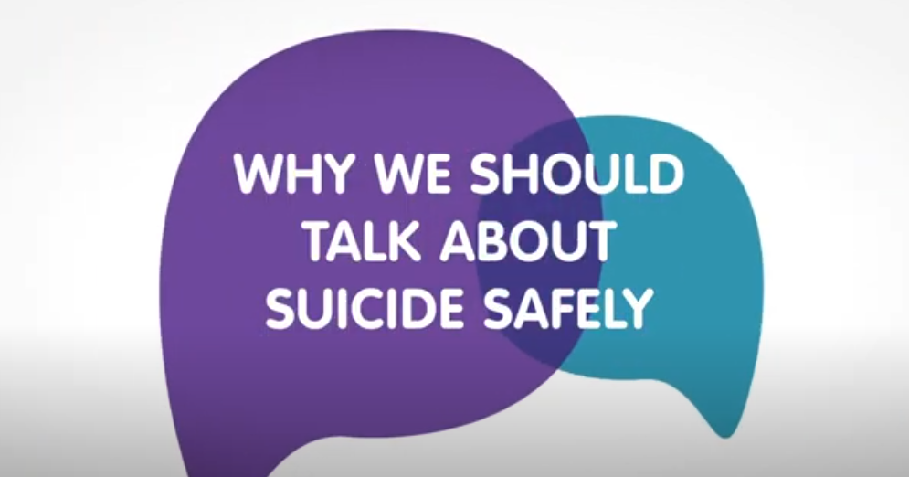

National strategies
Louis Appleby’s
National Confidential Enquiry
Notes:
Page 16 in booklets on suicide and technology – age old debate is social media a positive or a negative. Refer them to social media bitesize which looks in to how we can assess out young persons digital life in relation to its impact on their mental health.

Slide 60
Resources in the room
Notes:
What else do people know of or do?

Slide 61



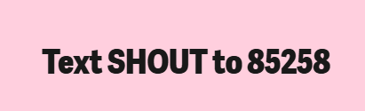


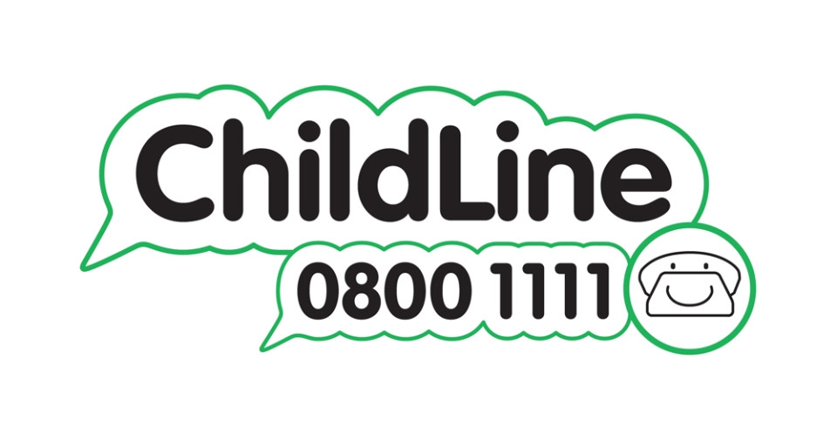



Support services and apps
Staying Alive
Notes:
Fran

Slide 62
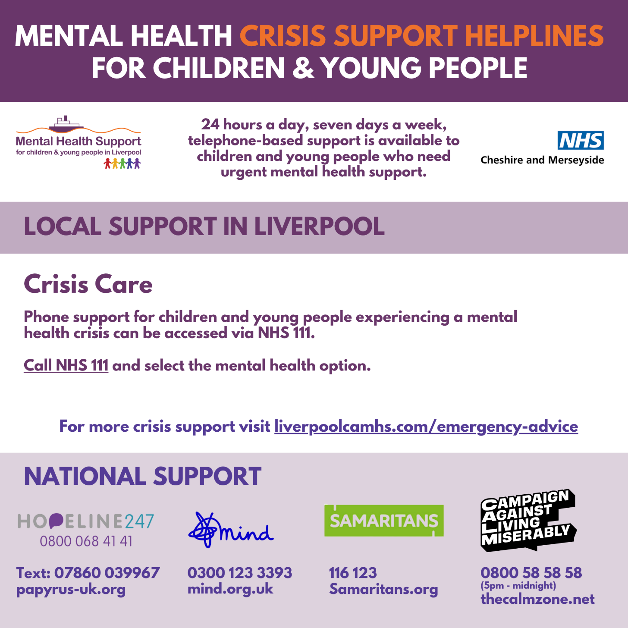

Slide 63


observe – watch out for relapses
O

Slide 64
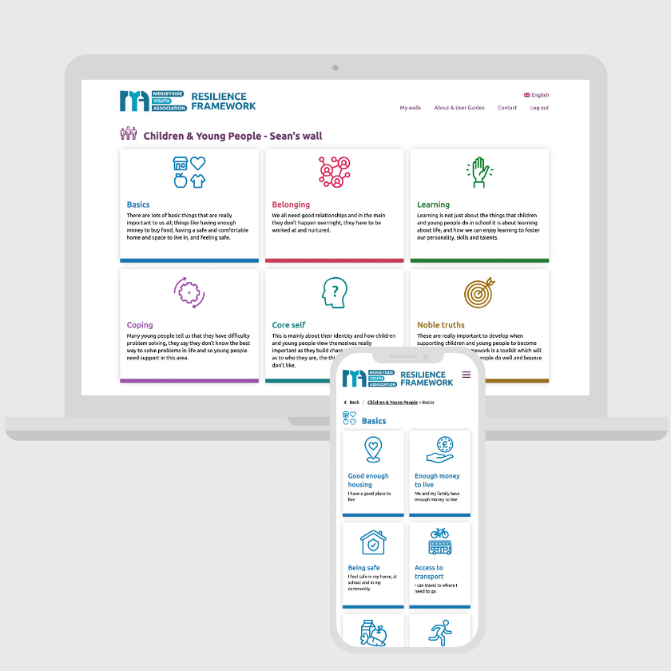
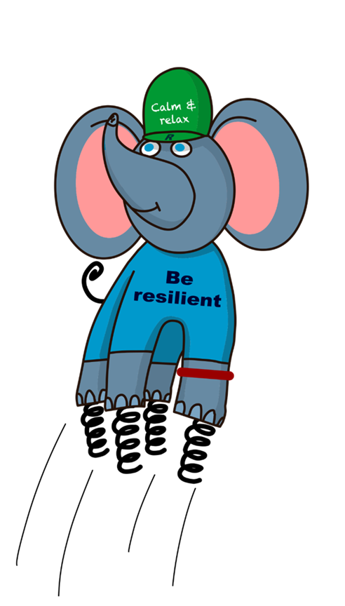
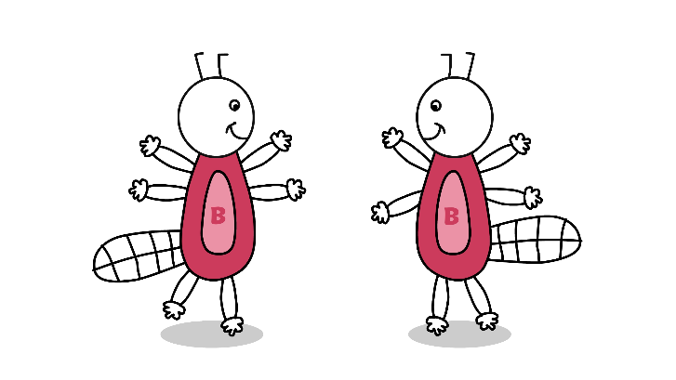
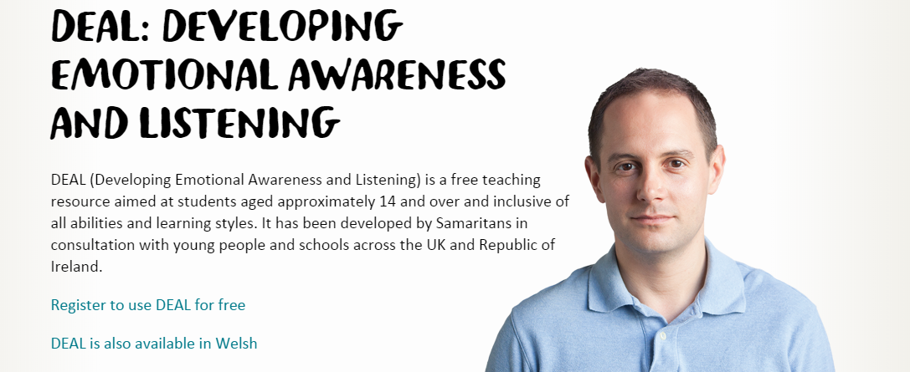
Resilience

Slide 66

Look after Yourself.
US
‘’Put your own oxygen mask on first.’’

Slide 67
Support
Speak to critical friends in your workplace.
Does your service offer counselling support for you?
Are there reflective practice opportunities to discuss the impact of the work you do?
Is there any bereavement training? (School improvement).
Access support from Child Bereavement UK.
Education staff can access the education hotline for 24/7 support.
Regular supervision opportunities.

Slide 68
What action will you take or something you will do differently?

Slide 69
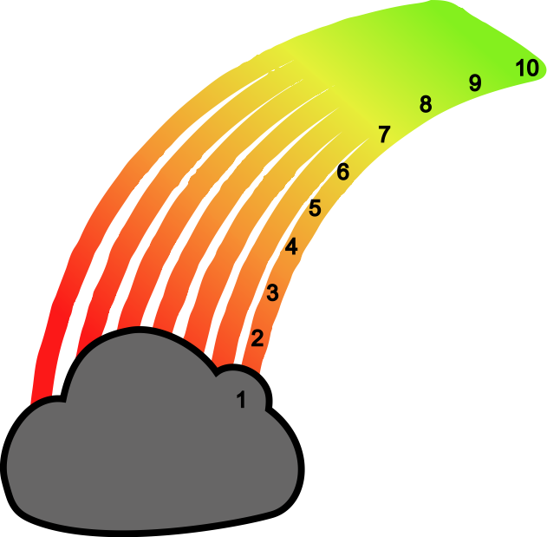
Check out
How are you
feeling?

Slide 70
‘ONS: Deaths registered in England and Wales (2019) section six ‘Leading causes of death’. www.ons.gov.uk/releases/deathsregisteredinenglandandwales2019
Suicide by children and young people, National Confidential inquiry into suicide and homicide by people with mental illness. July 2017. University of Manchester. https://sites.manchester.ac.uk/ncish/reports/suicide-by-children-and-young-people/
World Health Organisation, fact-sheets, suicide. www.who.int/news-room/fact-sheets/detail/suicide
On the Edge, Childline, Spotlight report on suicide. www.suicideinfo.ca/resource/siecno-20150292/
www.nspcc.org.uk/preventing-abuse/keeping-children-safe/mental-health-suicidal-thoughts-children/
www.health.ny.gov/prevention/injury_prevention/children/fact_sheets/10-19_years/suicide_prevention_10-19_years.htm
www.samaritans.org/active-listening
https://blog.oup.com/2016/09/impact-awareness-suicide-prevention-day/
https://documents.manchester.ac.uk/
Childline statistics and NSPCC Helpline statistics | NSPCC Learning
11. Over 105,000 Childline counselling sessions focus on children struggling with mental health issues | NSPCC
12. National Confidential Inquiry into Suicide and Safety in Mental Health https://nspa.org.uk/wp-content/uploads/2022/04/NCISH-2022-report-bookmarked-FINAL.pdf
13. National Confidential Inquiry into Suicide and Safety in Mental Health https://research.manchester.ac.uk/en/projects/national-confidential-inquiry-into-suicide-and-safety-in-mental-h
References

